Slide 1








MEGA MART
MEGA MART
STRATEGIC DATA INSIGHTS
A COMPREHENSIVE DASHBOARD TO MONITOR KEY METRICS DRIVING MEGA MART’S
SUCCESS ACROSS SALES, INVENTORY, AND LOGISTICS.

Slide 2

SALES PERFORMANCE KPIS:
TRACK KEY METRICS TO EVALUATE THE EFFICIENCY AND SUCCESS OF SALES EFFORTS.

Slide 3
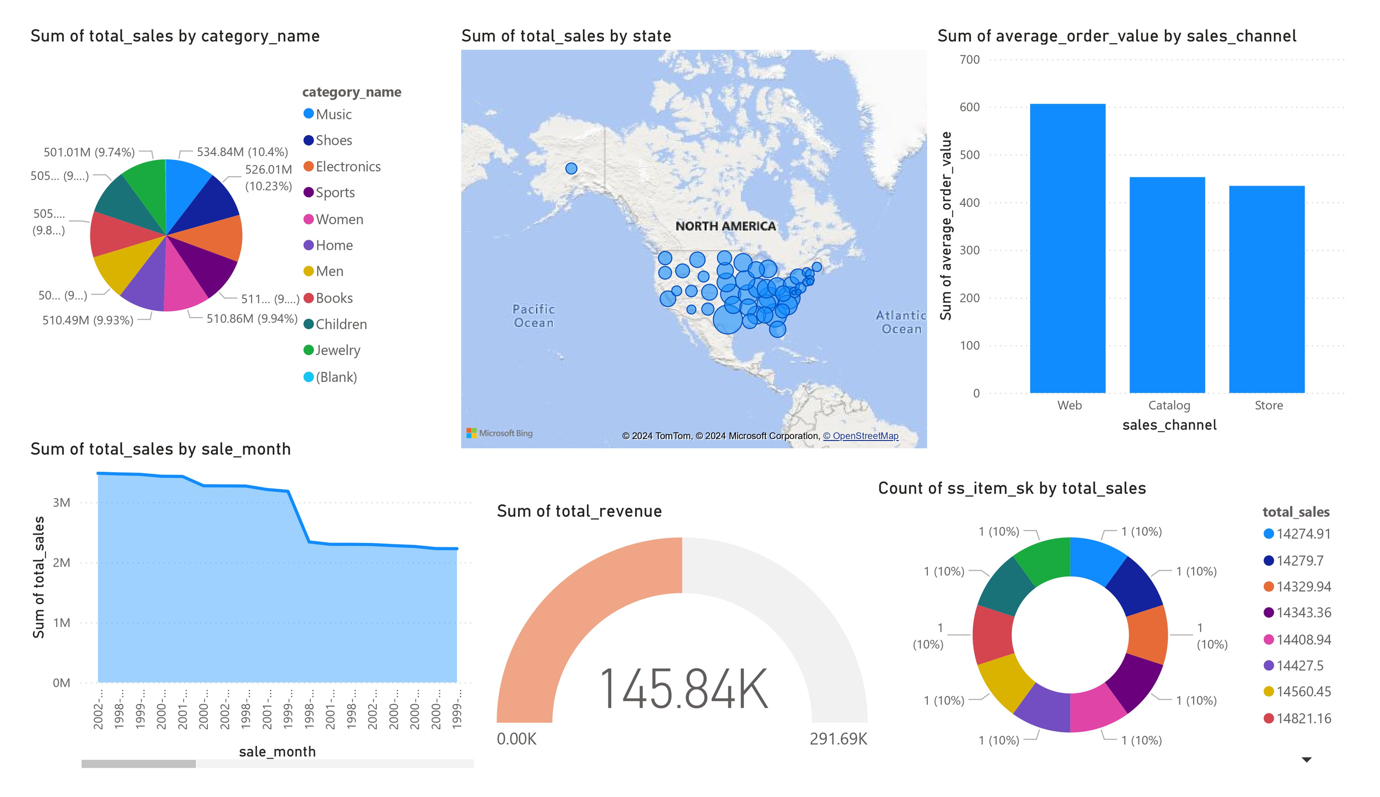

Slide 4
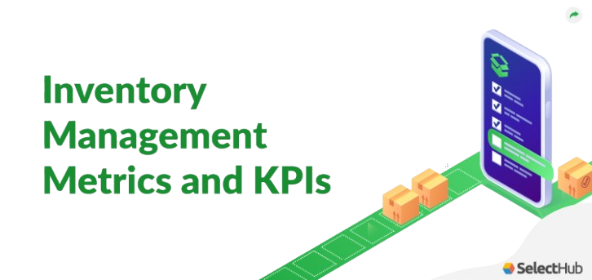
INVENTORY MANAGEMENT KPIS:
MEASURE STOCK LEVELS AND TURNOVER TO OPTIMIZE INVENTORY AND MINIMIZE COSTS.

Slide 5
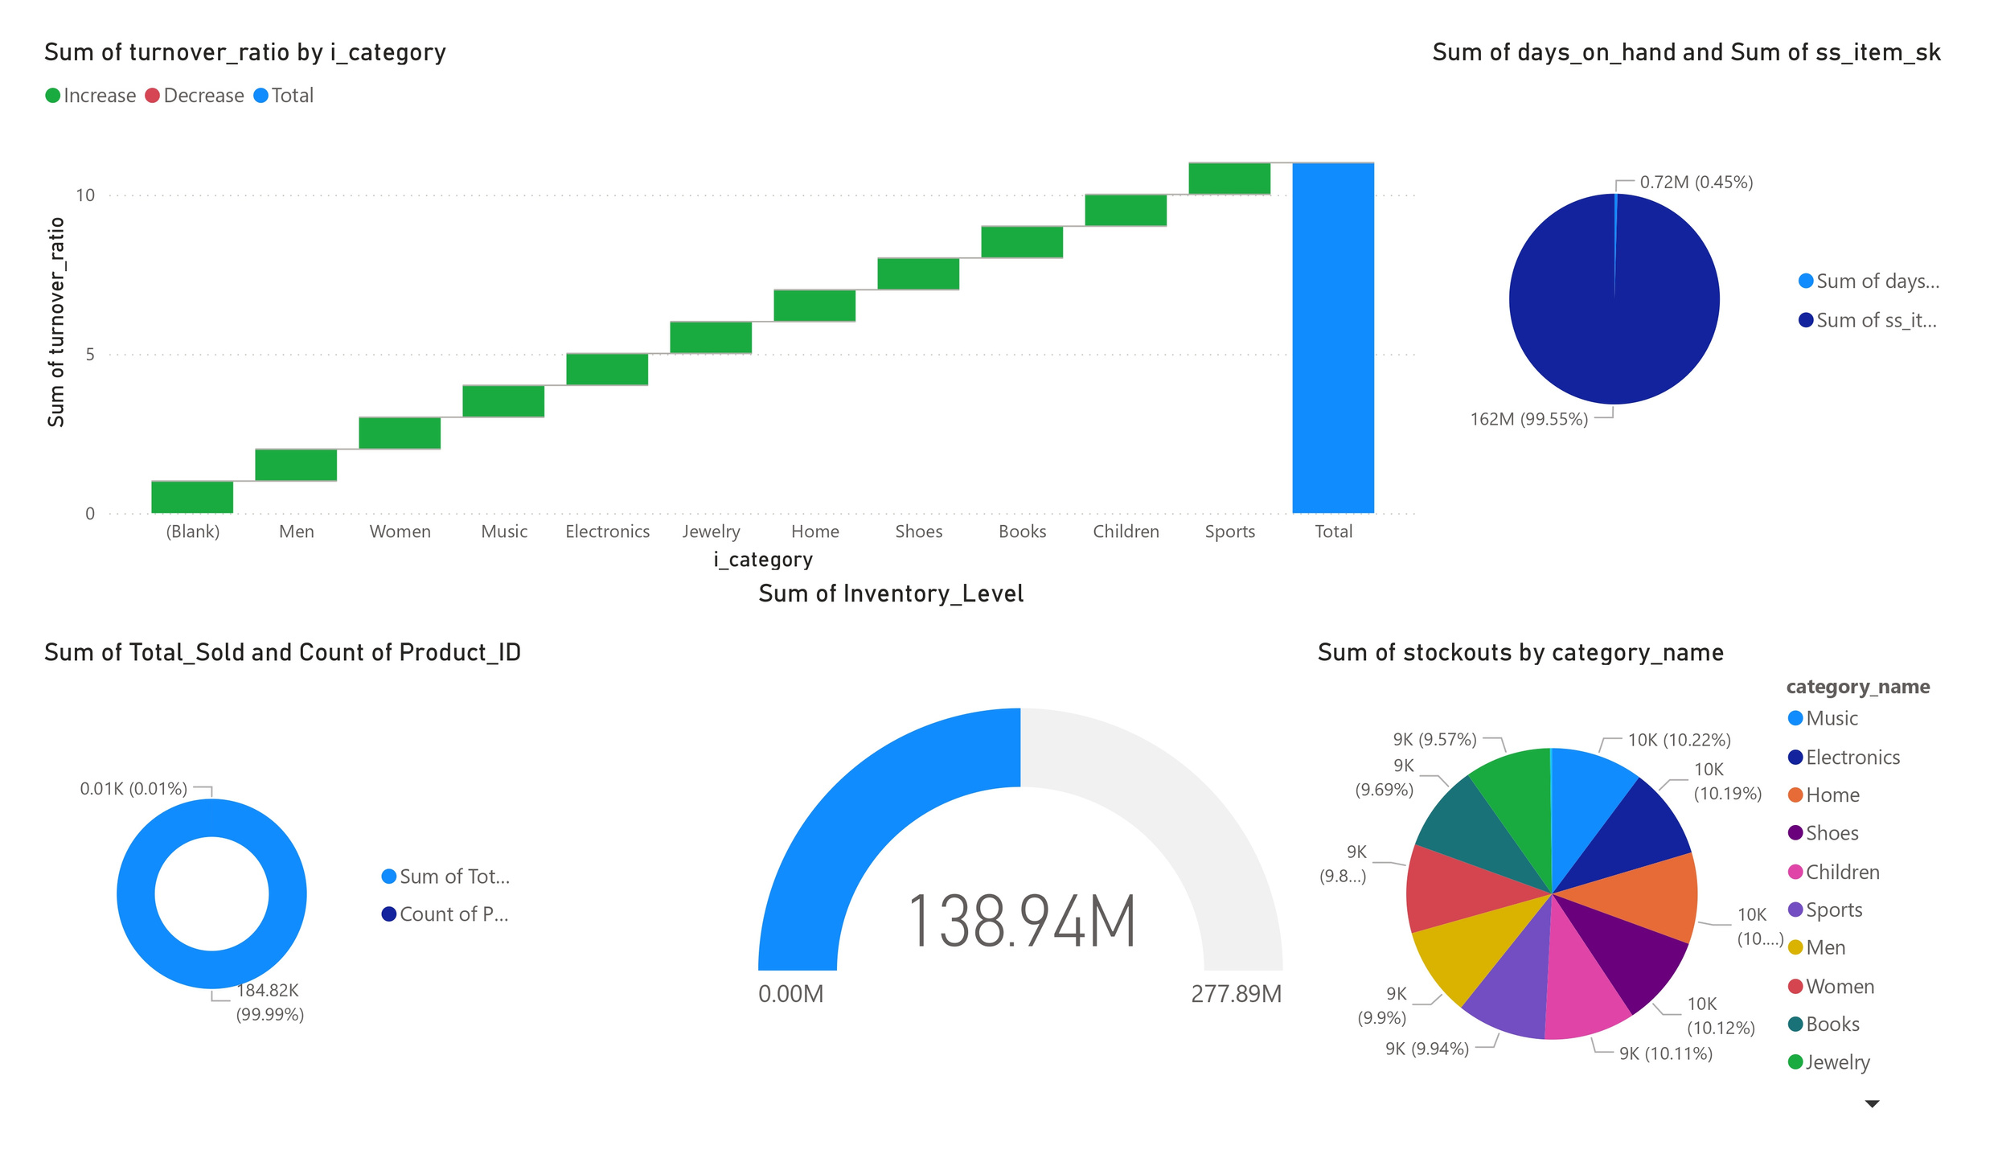

Slide 6
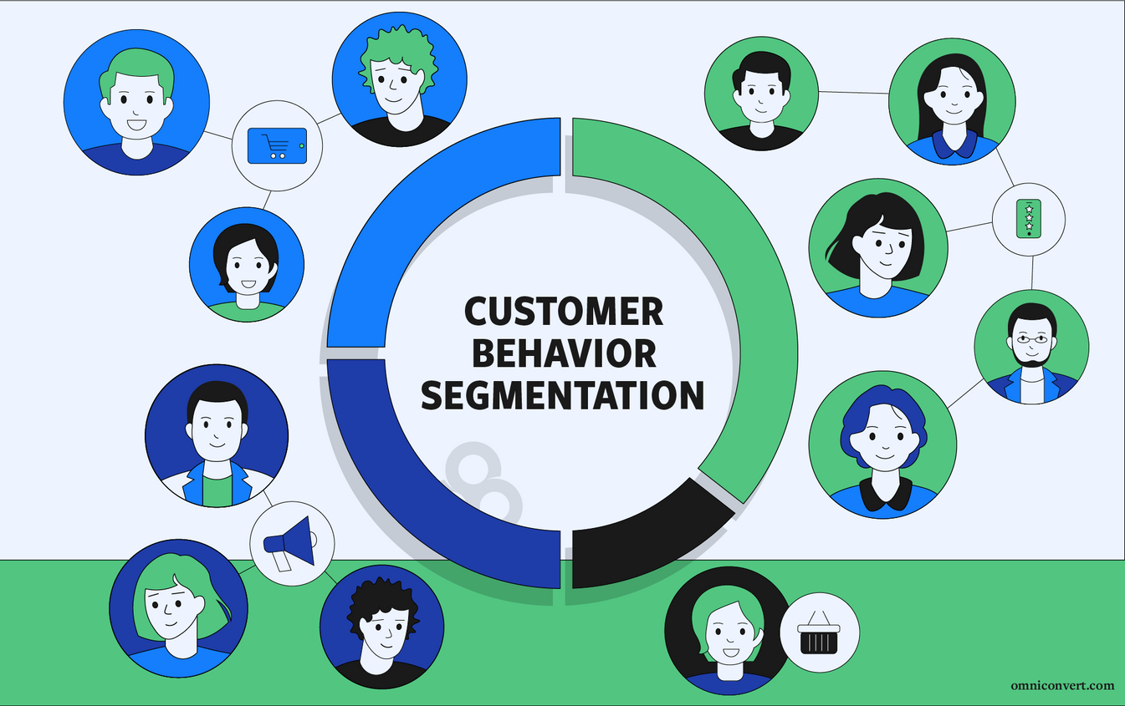
CUSTOMER BEHAVIOR
KPIS:
ANALYZE CUSTOMER PATTERNS TO ENHANCE ENGAGEMENT AND IMPROVE RETENTION.

Slide 7
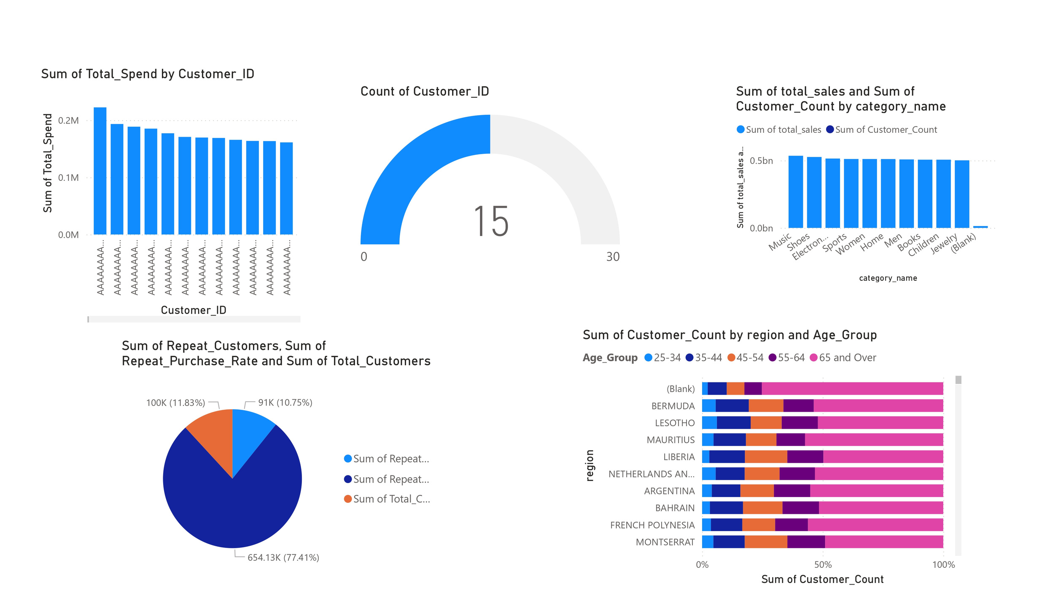

Slide 8
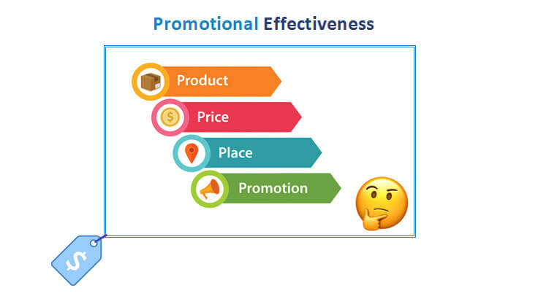
PROMOTIONAL EFFECTIVENESS KPIS:
ASSESS THE IMPACT OF PROMOTIONAL ACTIVITIES ON SALES AND CUSTOMER RESPONSE.

Slide 9
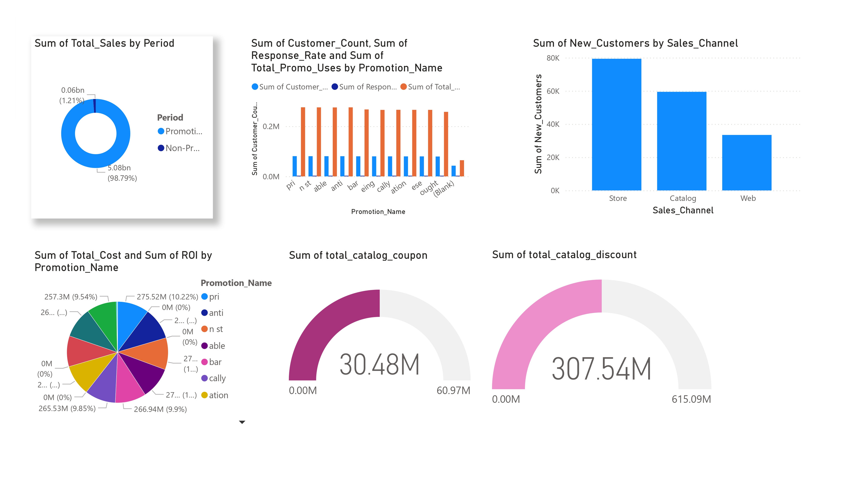

Slide 10

CHANNEL PERFORMANCE KPIS:
EVALUATE THE PERFORMANCE OF SALES CHANNELS TO IDENTIFY TOP-PERFORMING PLATFORMS.

Slide 11
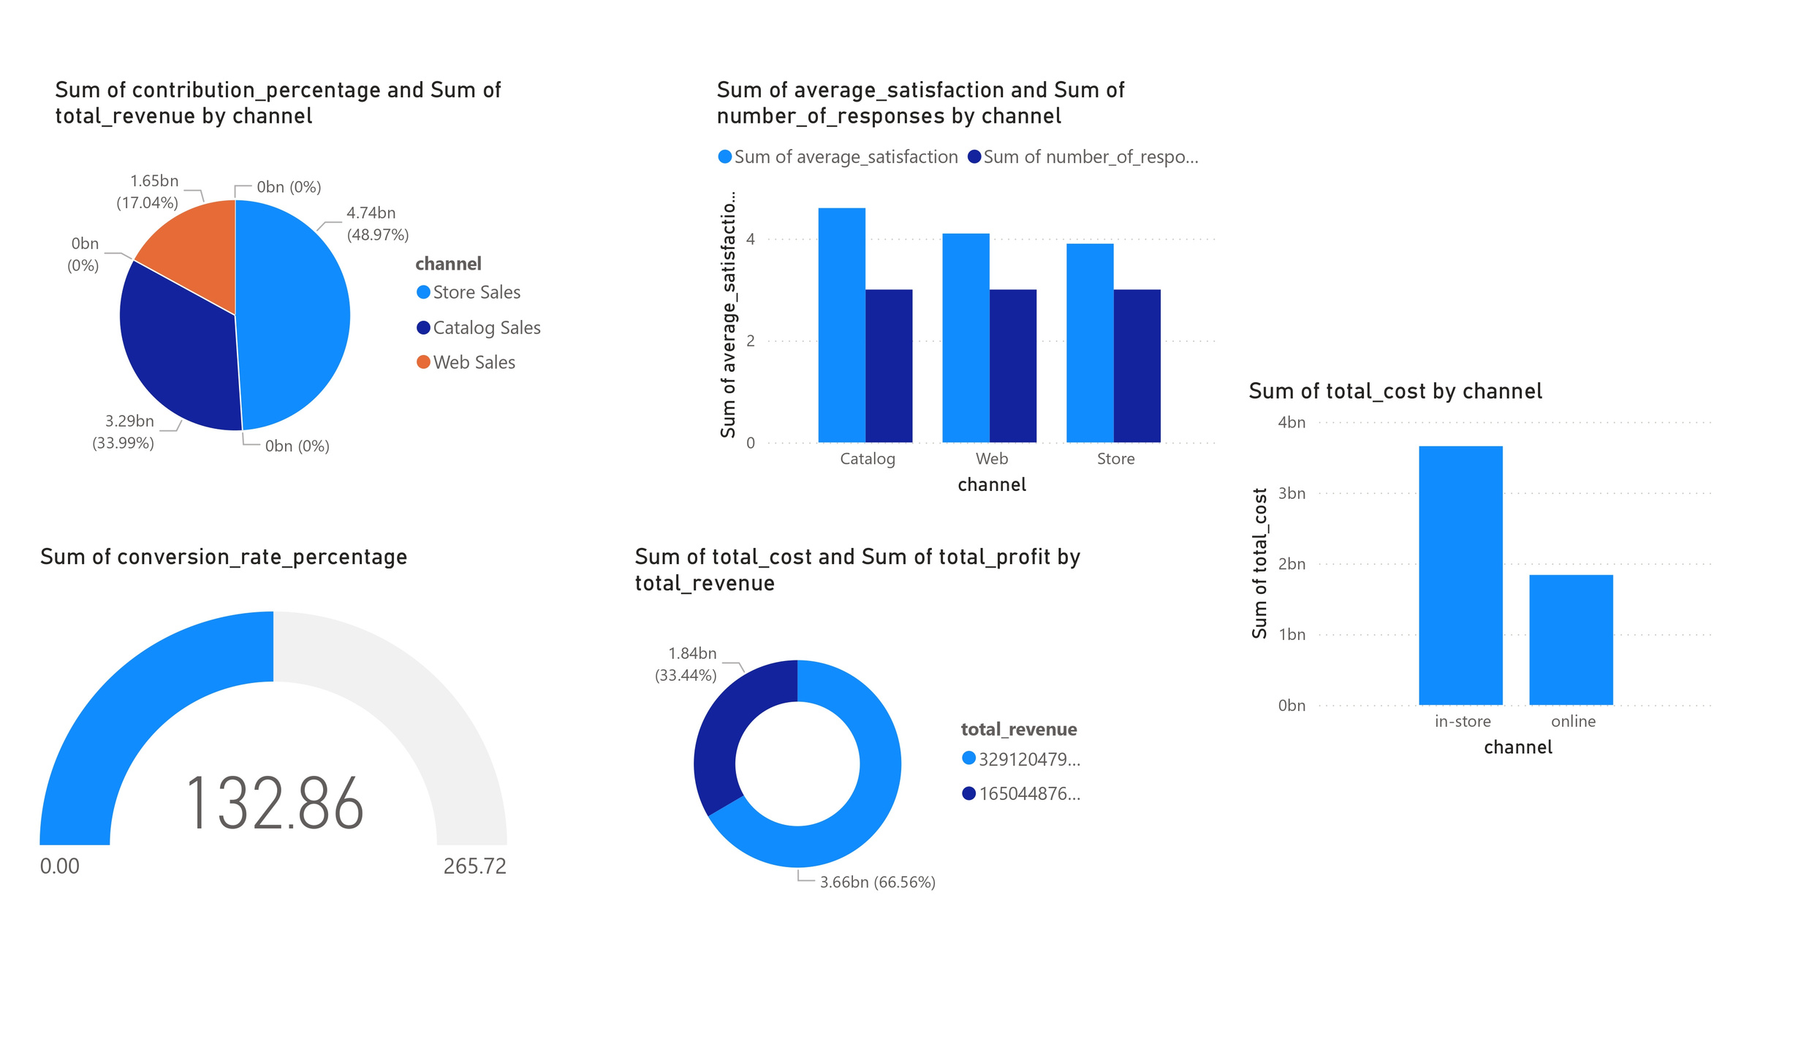

Slide 12

SUPPLY CHAIN
&
LOGISTICS KPIS:
MONITOR SUPPLY CHAIN EFFICIENCY, FROM PROCUREMENT TO DELIVERY.

Slide 13
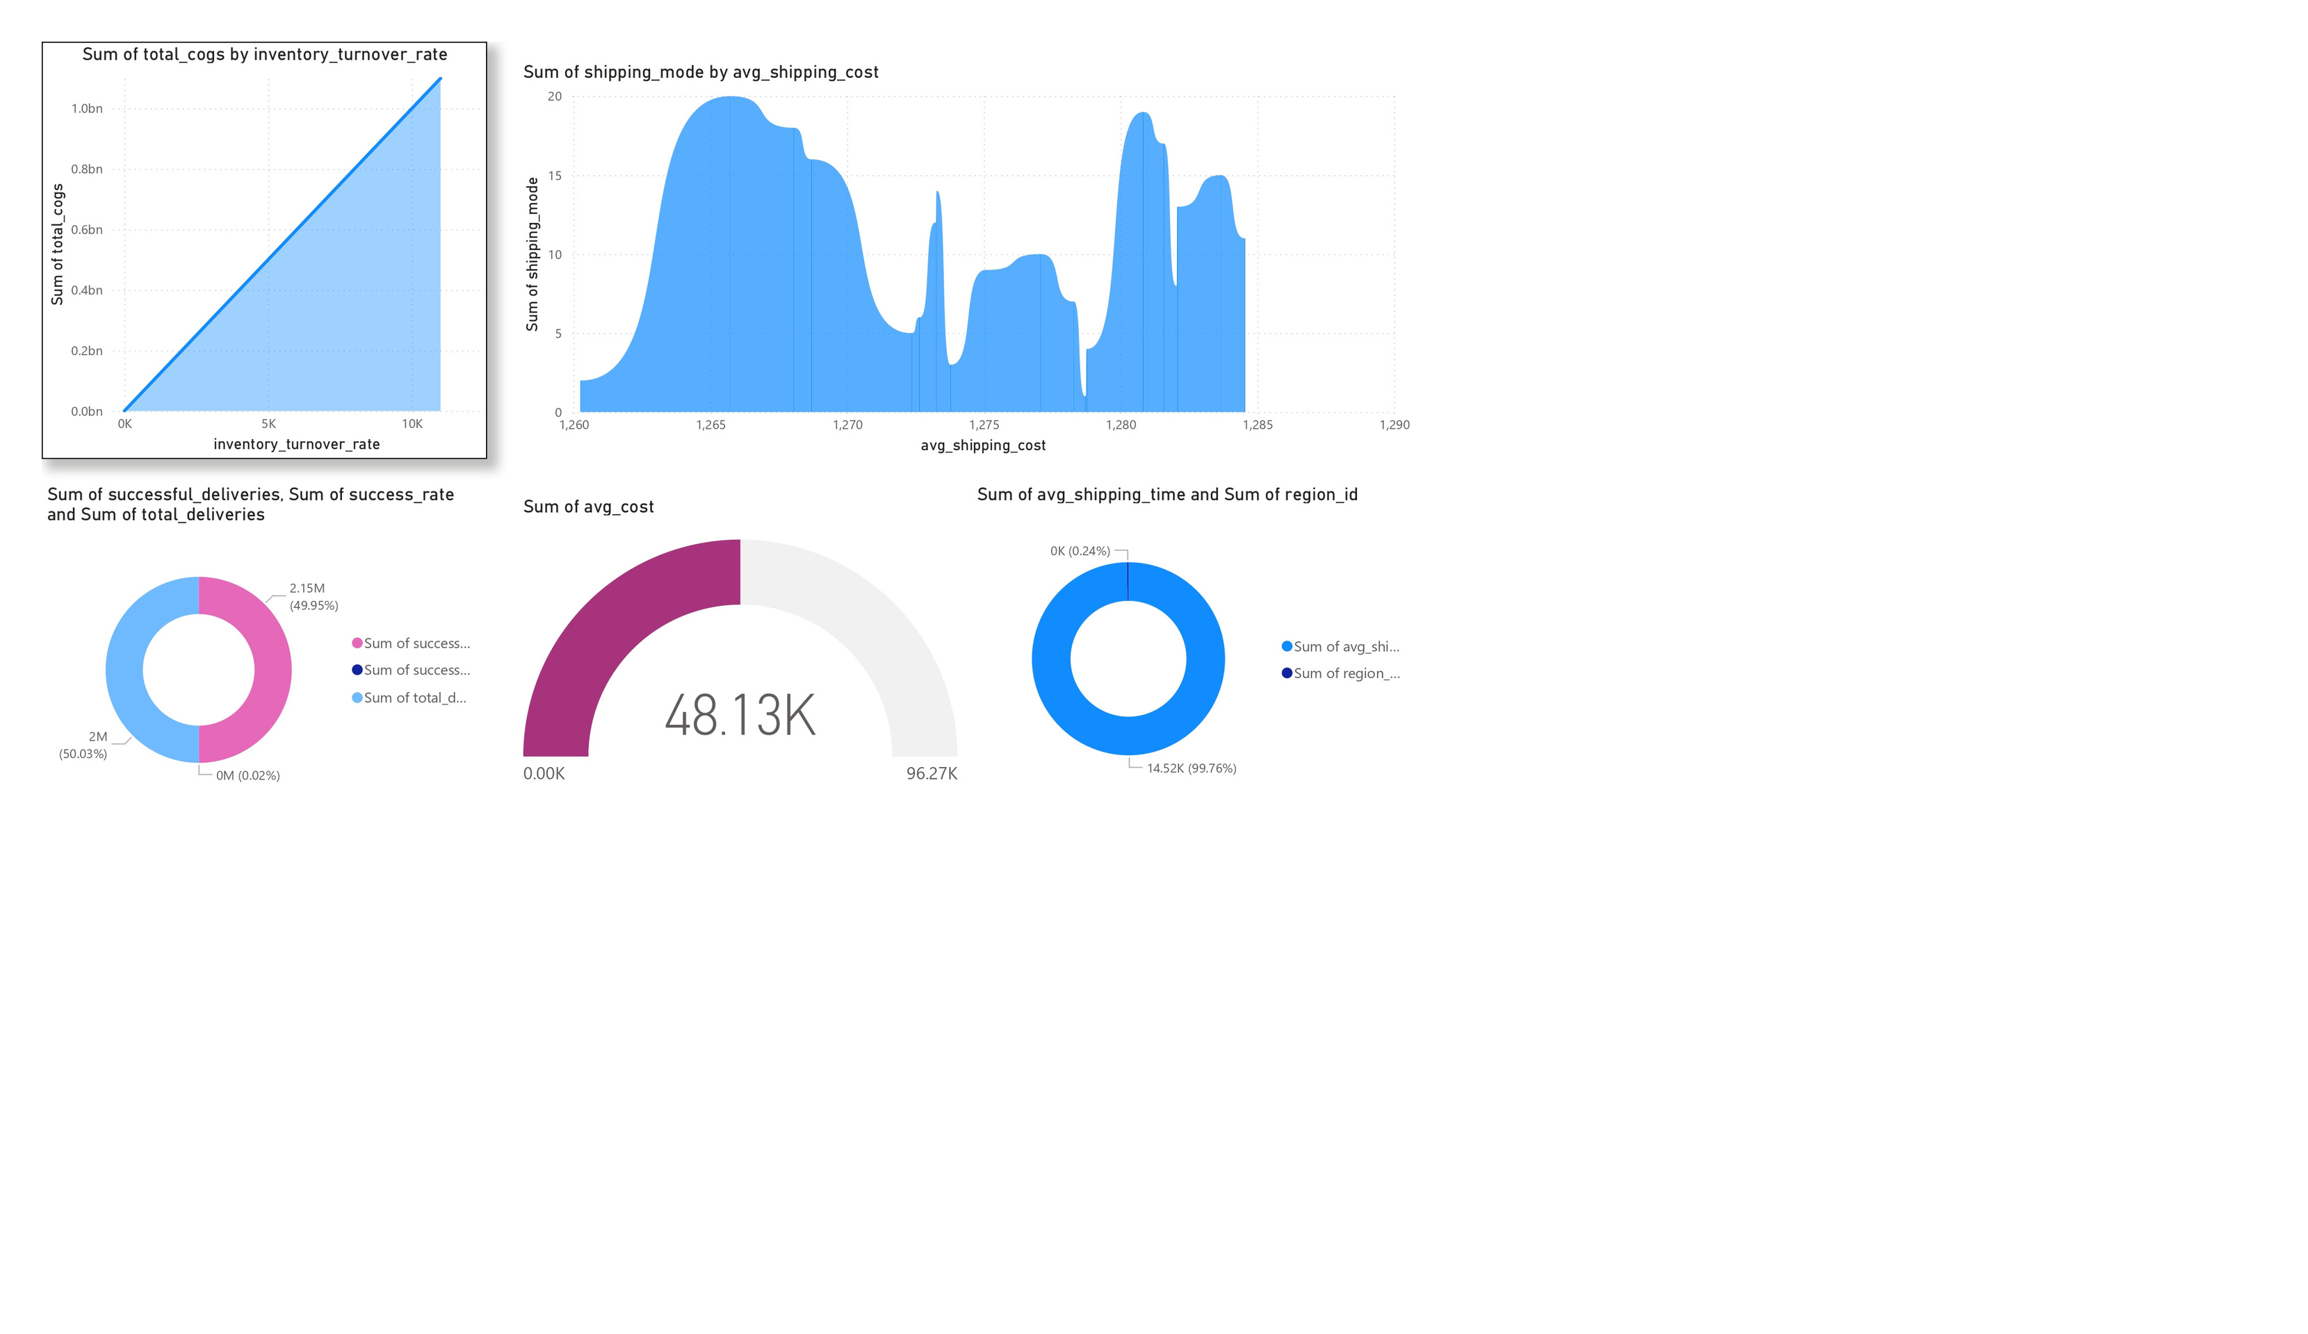

Slide 14


